Slide 1
Architecting Zero Downtime Database Deployments
Steve Jones, Redgate Software and
SQL Server Central

Slide 2
What is Zero Downtime?

Slide 3
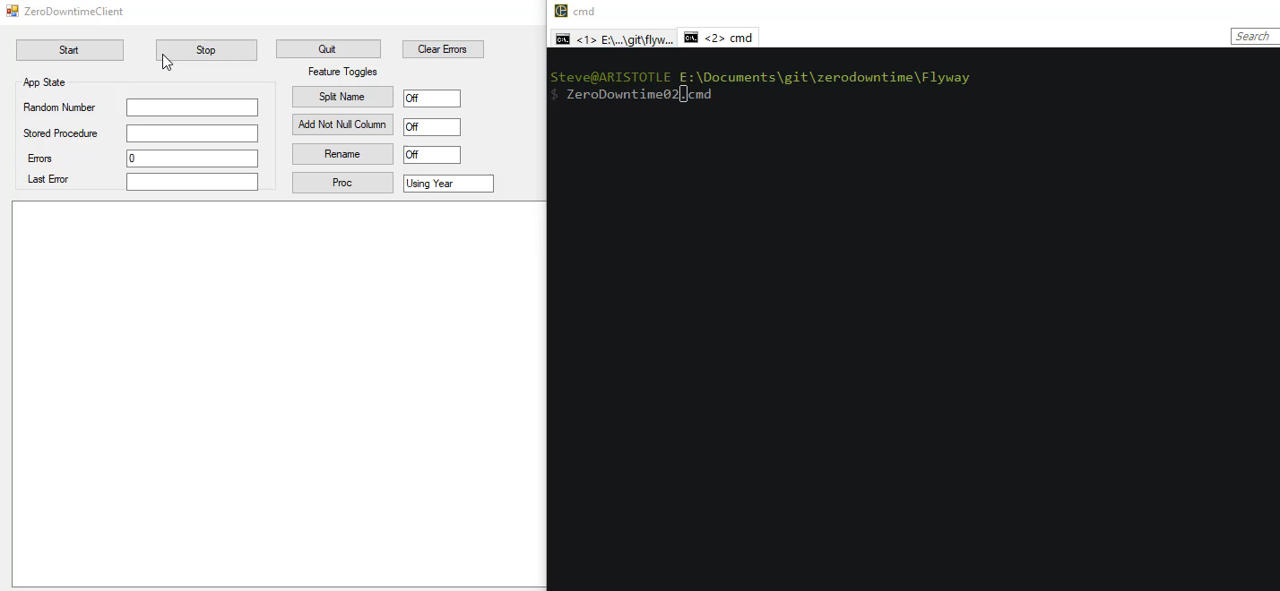

Slide 4
Zero downtime is
Not interrupting the customer (unnecessarily)
Not stopping business from running
Not stopping software from improving
Enhancements
Bug fixes
Maintenance
The appearance of 24/7 operation

Slide 5
Who Needs Zero Downtime?

Slide 6
Everyone

Slide 7
Zero downtime is important
We already have issues with customers
Technical Issues
Slow networks / broken connectivity
Software bugs
Database slowdowns
Machine failures
If our competition has less issues, customers churn

Slide 8
Databases are Complex
More complex than software
Relational databases are stateful machines
Schema has to evolve
Zero downtime isn’t possible
The goal is no interruptions to the client

Slide 9
DevOps Needs Zero Downtime
If we want to move at DevOps speed
We can’t have the database be a bottleneck
We can’t have database deployments be extraordinary
We can’t require humans to make changes

Slide 10
Adding a Not NULL Column

Slide 11
A Common Challenge – NOT NULL
We want to add a NOT NULL column
We can add with a default
All empty rows have the default
That might not be good
We can add NULL, add data, change to NOT NULL
Middle change can cause locking/blocking
Can take a long time
We can do better

Slide 12
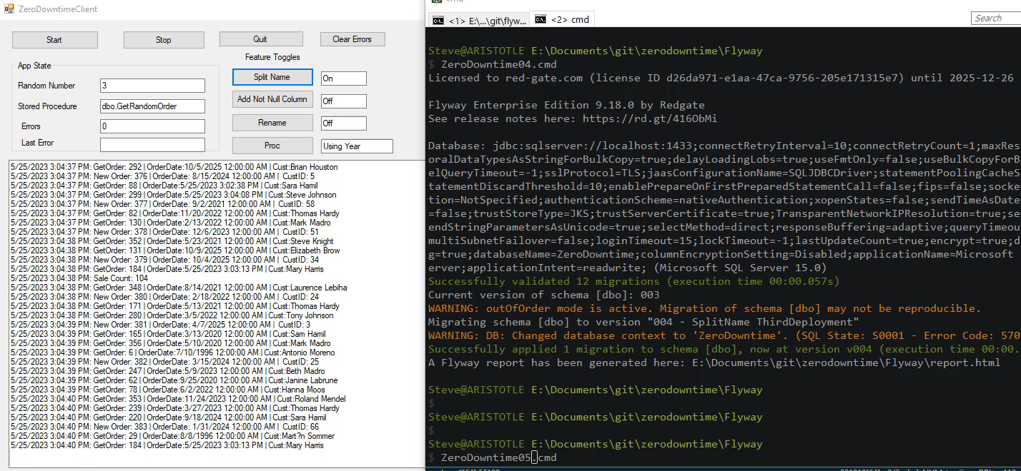

Slide 13
Zero Downtime Adding NOT NULL
Split work into 3 database deployments (1 app)
Add NULL column
Update Data
Alter column to NOT NULL
The application can deploy a feature toggle
Between 2 and 3 or with/after #3
We buy time to coordinate with all apps

Slide 14
Renaming a Column

Slide 15
Don’t Rename (but if you must)
SQL allows for different names
However, some people want to rename things
Typical process
Run rename (platform dependent), or
Add new column, move data, drop old column
Both of these can cause issues

Slide 16
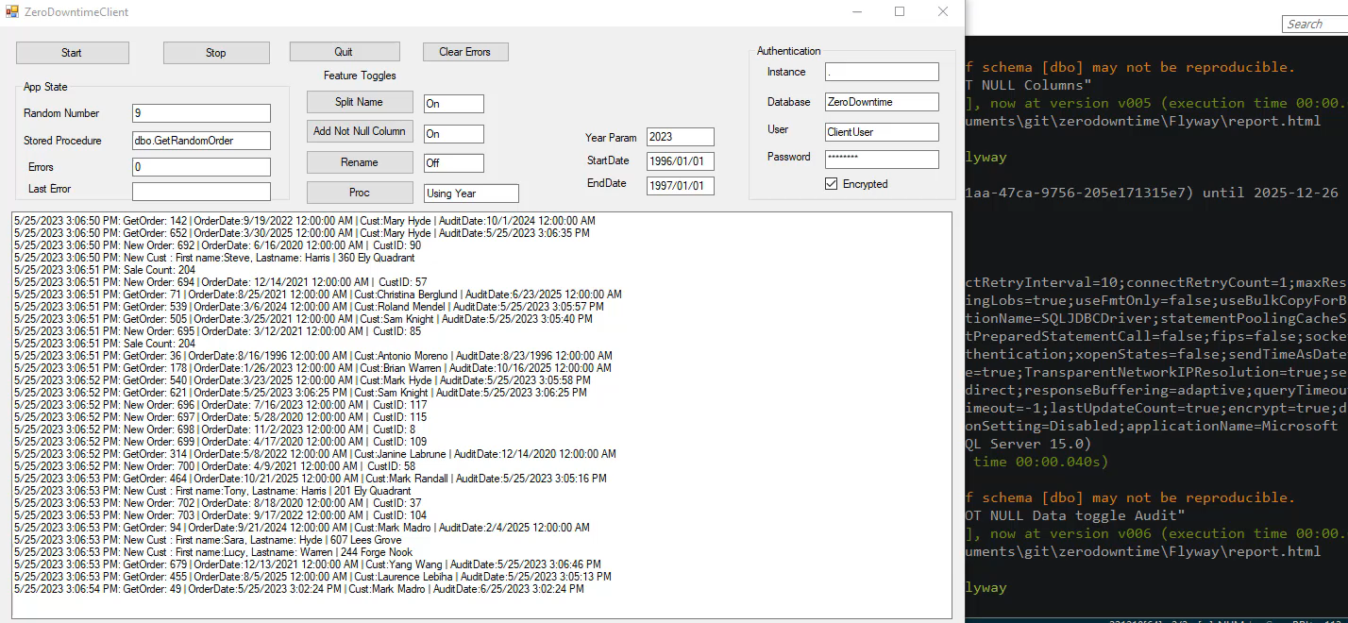

Slide 17
Zero Downtime Rename
Split work into 2 database deployments (1 app)
Add a new computed column (platform dependent)
Update dependent code/app
Drop computed column, rename old column (1 transaction)
We buy time to coordinate with all apps

Slide 18
Altering a Procedure / Function

Slide 19
Altering a Proc Changes the API
A procedure/function is an API
We should treat it this way
We will need to rev the API at some point
Typically
Add new parameters
Drop old parameters
Alter logic/result set
Often this throws errors somewhere

Slide 20
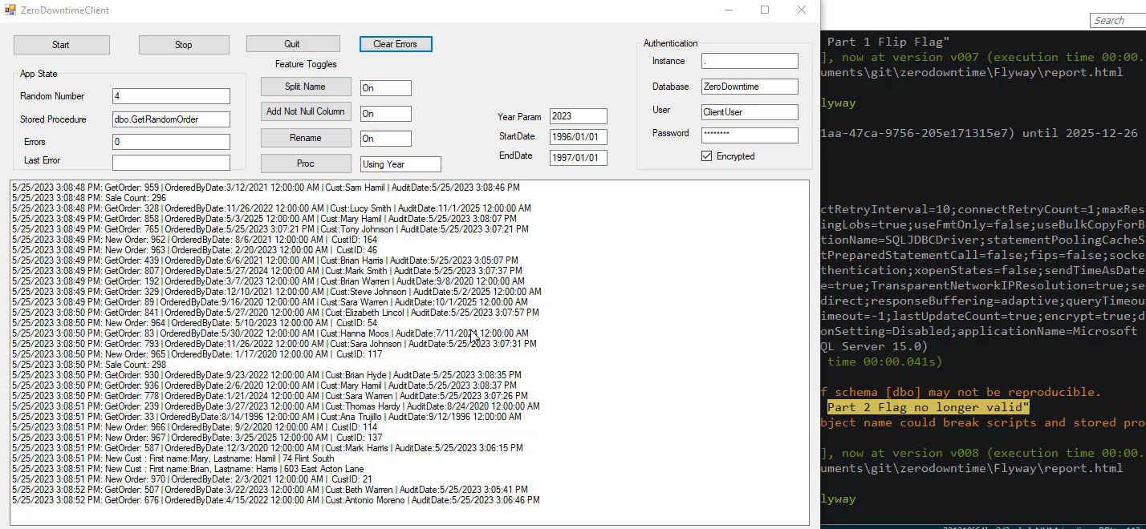

Slide 21
Zero Downtime API Change
Split work into 3 database deployments (2 app)
Add new parameters as optional – App prefers old
Alter logic to prefer new param (app deploy)
Alter proc to make old parameters optional
Alter logic to use new (app deploy)
Drop old parameters
We buy time to coordinate with all apps

Slide 22
Zero Downtime Patterns

Slide 23
Use Expand Contract
Use the Expand/Contract model (Martin Fowler)
Trade space for time
Store copies or new/old objects
Recover space later – puts pressure on app devs
Break up work
Ensure deployments are backwards compatible
If not, use multiple deployments
Blue/Green doesn’t work with databases

Slide 24
Work as a Team
Part of DevOps is being a team
We communicate, learn, share, adopt
Ensure app devs use good practices
feature flag everything
Use good SQL (no select *, insert column lists, etc.)
Use good error handling and retries
Log/trace errors and calls to deprecated objects

Slide 25
Database Dev Good Practices
Learn to break deployments into compatible stages
Ensure database devs use good practices
Use defaults
Name everything (indexes, defaults, parameters, etc.)
Use good SQL (no select *, insert column lists, etc.)
Never add/drop in the same deployment (same object)
Log/trace errors and calls to deprecated objects
Prefer stored procedures/functions for flexibility
Work with, not against, app developers

Slide 26
Run your own demo
This code/app is on Github
https://github.com/way0utwest/ZeroDowntime
SQL Server database code
VS 2019 C# project
Flyway (optional) for deployments

Slide 27


32 years database experience
DBA, developer, manager, writer, speaker in a variety of companies and industries using SQL Server, Oracle, and other database platforms.
Founder, SQL Server Central
Currently the editor in chief, with the goal of helping you learn to be a better data professional every day
Steve Jones
Architect / Advocate, Redgate Software
Editor, SQL Server Central
President, SQL Saturday 501.c.3 charity
he/him
16-year Microsoft Data Platform MVP
I have been honored to be recognized by Microsoft for the as a Data Platform MVP working with SQL Server
/in/way0utwest
@way0utwest
sjones@sqlservercentral.com
www.voiceofthedba.com
Notes:
Steve Bio

